Slide 1
Final
Project
BDAT 1001
INFORMATION ENCODING STANDARD

Slide 2


ASP.net app
User Data Protected
by Authorization
GitHub - https://github.com/rubaramanan/Asp.net_Auth_IES/tree/main/ContactManager

Slide 3

Team Members
Ramanan Thayalan (200565744)
Ishan Patel(200528548)
Niki Patel(200545936)
Anoushka Rastogi(200593018)

Slide 4

Project Summary
The project involves creating an ASP.NET Core web application that uses an authorization-based approach to protect user data. Users are categorized into three security groups: Administrators, Managers, and Registered Users. This setup, inspired by a lesson from Microsoft Docs, demonstrates the practical application of authorization controls in web development.

Slide 5

Model Implementation
Role-Based Security Groups:
Implementation of three distinct security groups for data protection. We have in total 3 security groups. Those detailed are stated below.
Registered Users: Can view all approved data and manage their own information. Managers: Have the authority to approve or reject contact data, with access limited to approved contacts only. Administrators: Have complete control over data, including the ability to approve, reject, edit, and delete any data.
Framework: ASP.NET Core
HTML and CSS: For designing user-friendly interfaces.

Slide 6
Demonstration
Entity Framework Core and ASP.NET Core
Role-Based Authorization
Model-View-Controller (MVC) Architecture

Slide 7
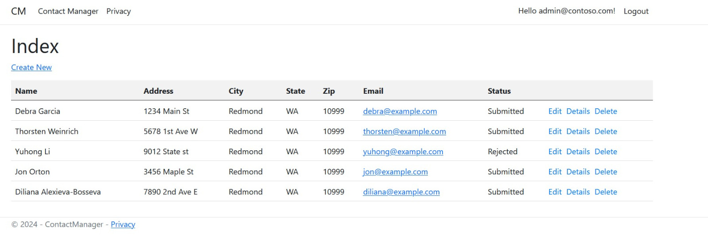
Administrator View

Slide 8
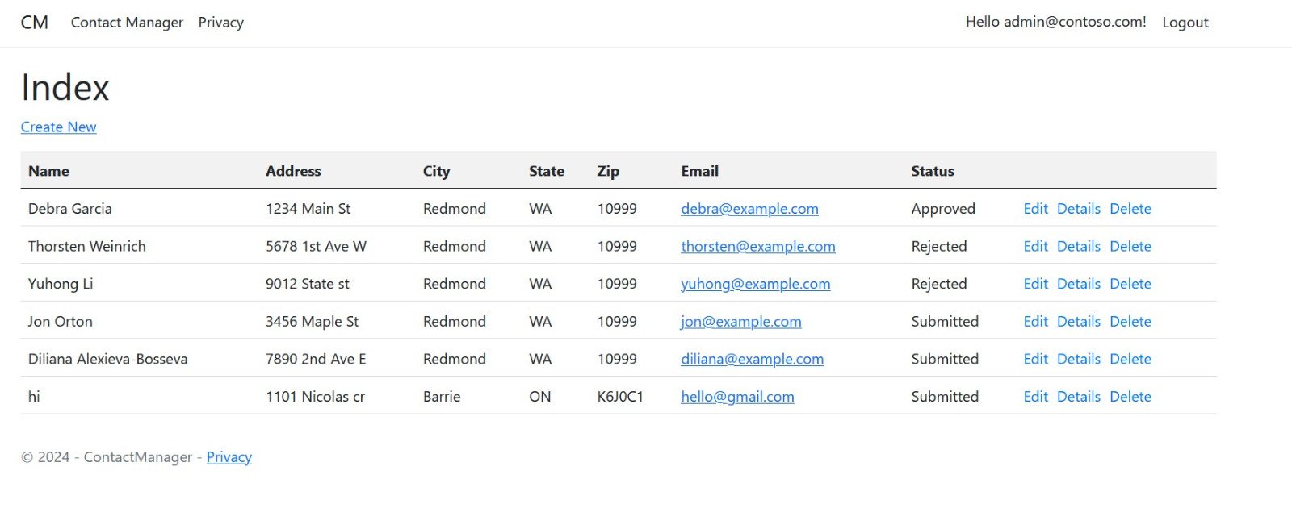
Administrator View

Slide 9
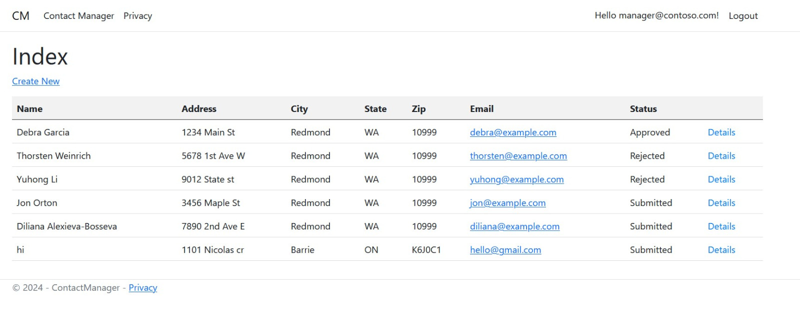
Manager View

Slide 10
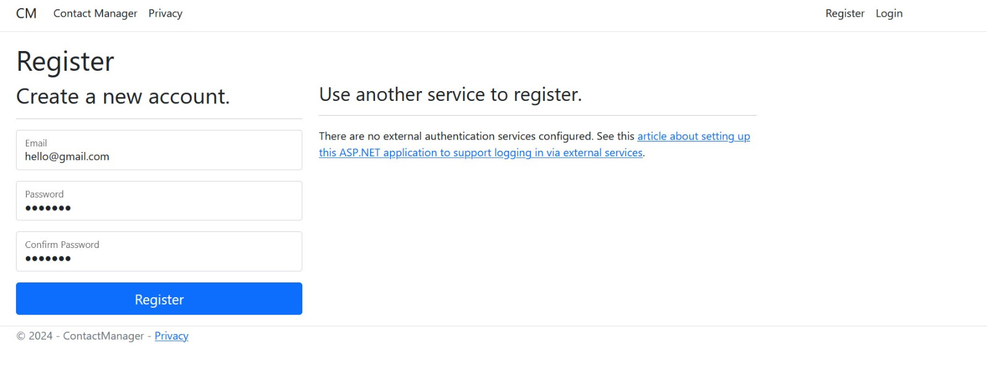
Register

Slide 11
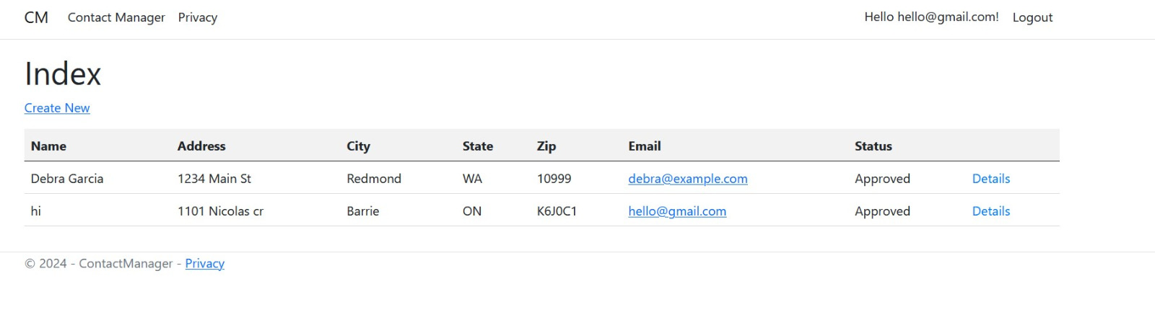
Registered User View

Slide 12
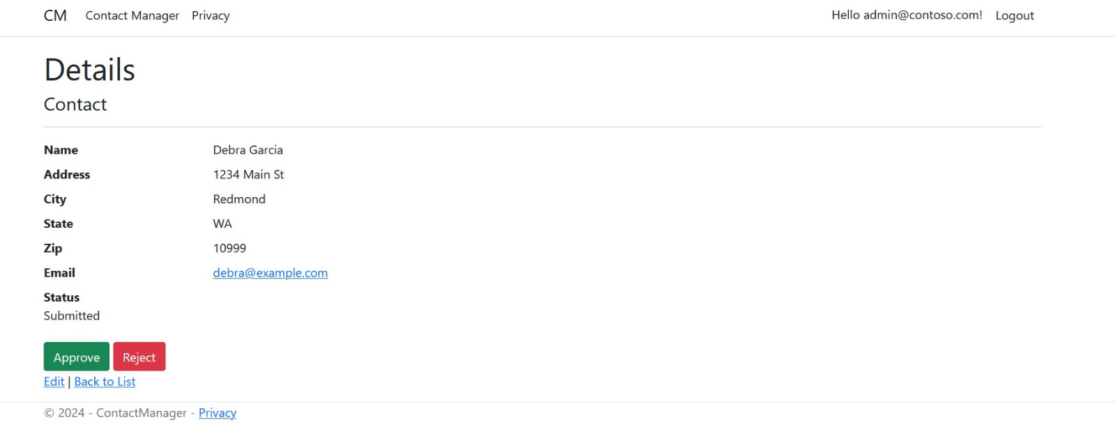
Administrator
Approve & Reject View

Slide 13
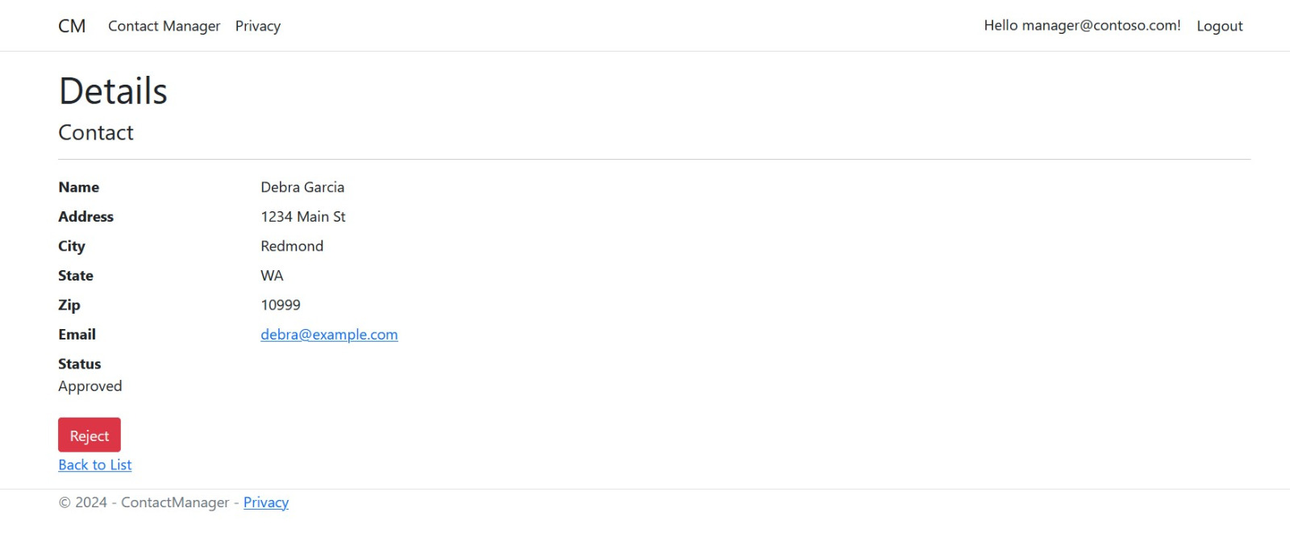
Manager
Approve and Reject View

Slide 14

Thank you

